Slide 1
Maine Health Data Organization
Board of Directors Retreat
Barbara Sorondo, MD MBA
Director EMMC Clinical Research Center
June 5, 2014

Slide 2
Outline
Purpose
  Describe recent projects that utilized multiple data sources
  Describe some limitations of the access of the data
Examples
  Bangor Beacon Community
  High Value Healthcare Collaborative

Slide 3
Bangor Beacon Community –ONC Grant
Objectives: Triple Aim
Data sources: EHR, HIN, Patient Reported
Limitations: Lack of time sensitive claims data,
Lack of patient crosswalk
Inability to identify the financial impact of the Interventions
4. Solutions Prospective Cohort
Using HIN to identify the utilization
5. Results Improve Quality,
Reduce Utilization,
Improve Patient Experience

Slide 4
Bangor Beacon Community
Evaluation of the Care Management Model on High Risk High Cost Chronic Condition Patients
Evaluation of a Multi-institutional Regional Collaboration for Quality Improvement for Patients with Chronic Conditions
Bangor Community
Bangor Beacon Chronic Condition Patients
Bangor Beacon High Risk/High Cost Patients
2
1

Slide 5
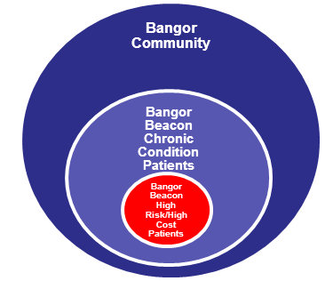
Healthcare Goals
1. Evaluation of the Care Management Model on High Risk High Cost Chronic Condition Patients
Outcomes
Quality: Better Care
Cost: Affordable Care
Experience: Improved Experience of Care
Clinical and Preventive Measures (EHR)
Healthcare Utilization (HIN)
Patient Reported Measures

Slide 6
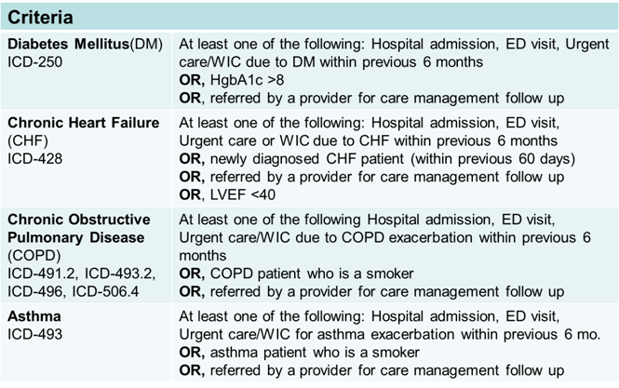
1. Evaluation of the Care Management Model on High Risk High Cost Chronic Condition Patients
Intervention Group
  Patients from BBC primary care practices
Control Group
  Patients from:
    Non BBC primary care practices
    Specialty care practices
    No PCP
 | Visit 1 (Enrollment day) | Visit 2 (six months after enrollment) | Visit 3 (12 months after enrollment) | Visit 4 (18 months after enrollment)
Informed consent form | X
Patient Demographics | X
Past Medical History | X
Vital Signs | X | X | X | X
Disease-Specific Tests or Management (HbA1C, LDL, as applicable) | X | X | X | X
Health care utilization/cost related outcomes --past 30 and 180 days(Visit 1); past 180 days (Visit 2, 3, 4) | X | X | X | X
Immunization compliance | X | X | X | X
PHQ-2 Depression question | X |  |  | X
Medication adherence (Modified Morisky Scale (MMS)) | X | X | X | X
Chronic Disease Self-efficacy Scale (CDSES) 6 item | X | X | X | X
EQ-5D Quality of Life Survey | X | X | X | X
Patient satisfaction and perception of care (adapted CAHPS survey with addition of a chronic care module (Visit 1 and 4) and a care manager module (Visit 4) | X |  |  | X
5

Slide 7
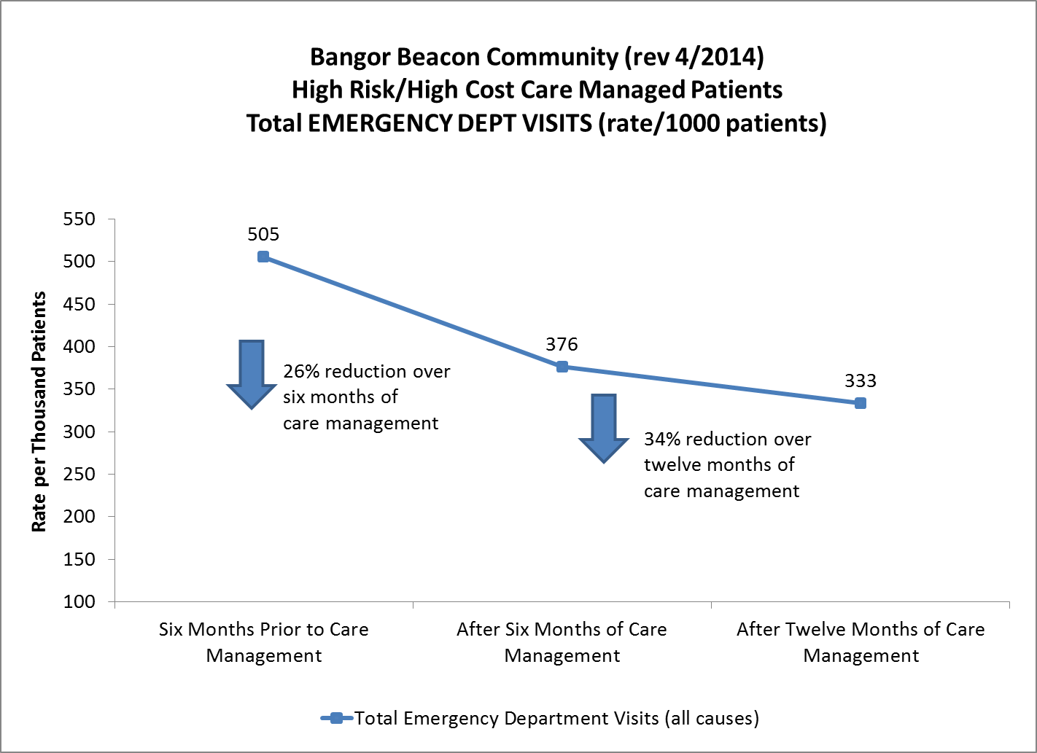
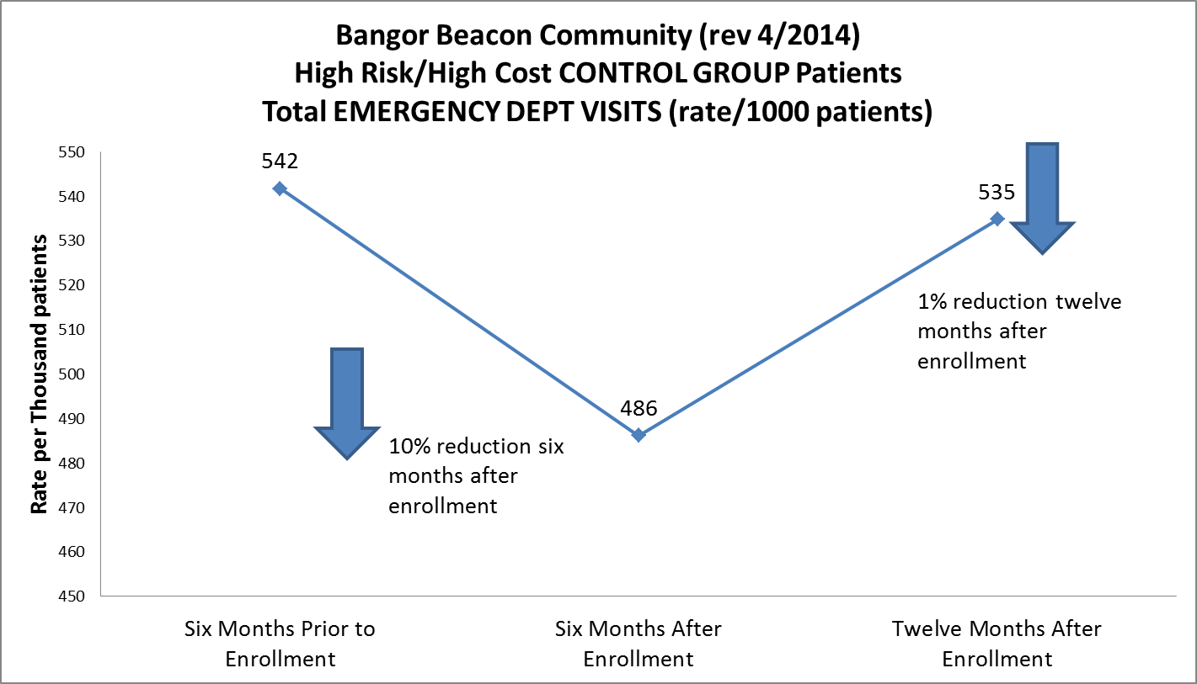
1. Evaluation of the Care Management Model on High Risk High Cost Chronic Condition Patients
Results -- Healthcare Utilization _ ED visits

Slide 8



2. Evaluation of a Multi-institutional Regional Collaboration for Quality Improvement for Patients with Chronic Conditions
Consensus on metrics and target goals
Centralization of data abstraction and reporting
Transparently sharing information and best practices
Practice of Plan, Do, Study, Act (PDSA) approach.

Slide 9
Performance Improvement Intervention Process
Bangor Beacon Community
Healthcare Systems
Primary Care Practices
Primary Care Providers
Care Managers

Slide 11
Provider’s Comparison by Healthcare Organization
Reports

Slide 12
Interventions

Slide 13



Performance Improvement Intervention
Successful Interventions
Work flow: MA driven protocols including:
  depression screening,
  preparation of patients for foot examination,
  LDL audits
EHR: New and revised forms, clinical protocols, alert systems and decision support tools
Data auditing
Point of care testing
  Hb A1c

Slide 14


Performance Improvement Intervention
Results: Improvement in Quality
From September 2010 to January 2013
1. Metrics reaching interim or BBC goals:
  68% 82%
2. Metrics improved:
DM metrics: 13/19 (68%)
    CVD metrics: 10/12 (83%)
    COPD metrics: 6/7 (86%)
    Asthma metrics: 6/6 (100%)
Limitation: No cost or savings associated to the interventions, lack of patient crosswalk

Slide 15
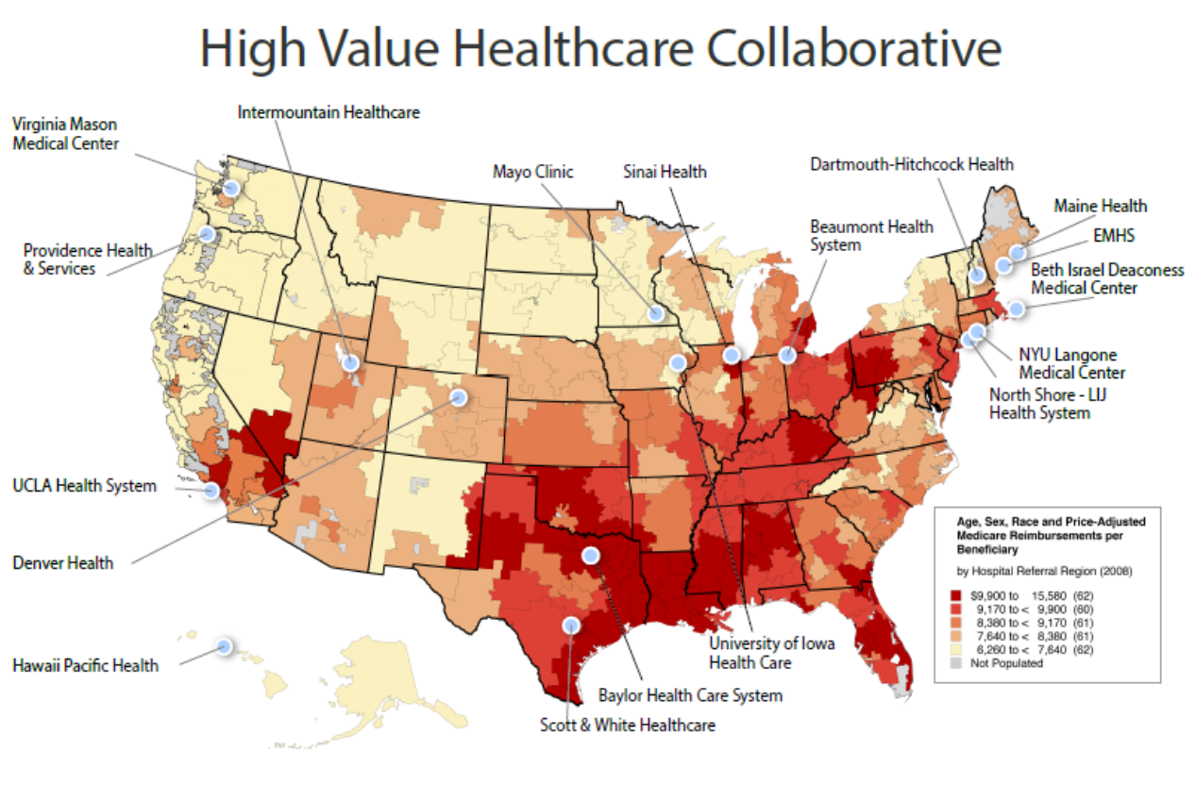
“Engaging Patients to Meet the Triple Aim”. CMMI, 2012

Slide 16
“Triple Aim +” by John Wennberg , MD
  Improve Quality
  Reduce Cost
  Improve Patient Experience
  Improve Providers Experience

Slide 17
High Value Healthcare Collaborative
Patient level
Clinic level
Hospital level
HVHC
Claims Data
Clinical Data
Patient Reported Measures
Patient Crosswalk
Benchmarking to
identify best practices
2. Address clinical project team questions
3. Measure impact of
Interventions
4. Inform Patient Care

Slide 18
HVHC Project Overview - Goals
 | Sepsis | Heart Failure | Hip & Knee
Improve Care | Improve adherence to sepsis bundled care by 5% | >50% eligible patients referred to Shared Decision Making (SDM) and >50% of referred patients/families participate in SDM interventions Improve Patient Experience
Improve Health | Reduce the burden of chronic morbidity from sepsis-associated chronic organ dysfunction | Reduce emergency department rates and hospitalizations by 10% | Improve health status measures (function, pain) for >50% of patients considering hip and knee surgery at one year. Metrics used will include: Hip disability and Osteoarthritis Outcome Score (HOOS) , Knee injury and Osteoarthritis Outcome Score (KOOS); Harris Hip Score (HHS) and Knee Society Score (KSS)
Reduce Cost | Achieve a 5% (relative rate) reduction over three years in the number of patients with sepsis requiring long term acute care or sub-acute nursing care after an incident episode of severe sepsis. | Reduce cost of annual episodes by 2% for complex patients with CHF | Reduce rates of surgeries (hip, knee) and episode utilization resulting in 5% total cost reduction.

Slide 19
  High Value Healthcare Collaborative
Objectives: Triple Aim
Data Sources: EHR, patient reported measures,
claims data
Limitations: Data Standardization
Preliminary results: Improvement in patient experience, Improvement in quality, reduction of Medicare payment

Slide 20

Barbara Sorondo, MD MBA
bsorondo@emhs.org

